Slide 1
Tutorial 8: Message Passing and Stateful Objects

Slide 2
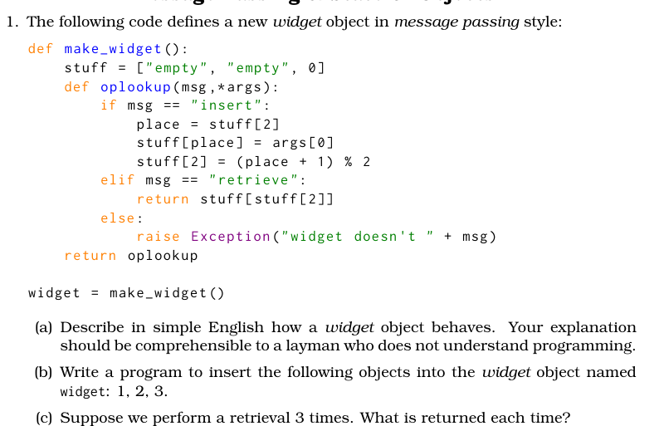
Q1: Question Analysis

Slide 3
Q1: What is a widget?
A widget is a series of messages
We can either use msg = “insert” to add a new message to the widget or msg='retrieve' to retrieve the second most recent message The widget will store the most recent 2 messages passed to it

Slide 4
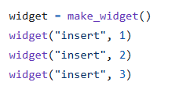
Q1: Insert
How to insert 1, 2, 3 into the widget?

Slide 5
Q1: Retrieval
What will be retrieved now?
2, 2, 2

Slide 6
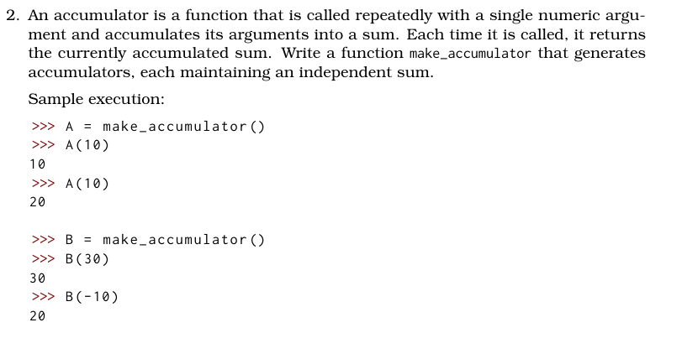
Q2: Question Analysis

Slide 7
Q2: Question Analysis
What is the return type of make_accumulator?
A Function!

Slide 8
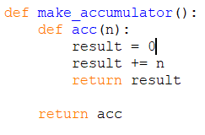
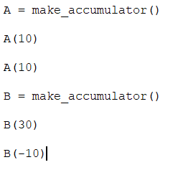
Q2
Does this work? What will the output be?
No! Result is initialized to 0 after every call of acc

Slide 9
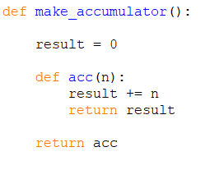
Q2
Does this work? What will the output be?
No! There will be an error! Why?

Slide 10
Q2
Our goal: To modify a variable from the enclosing scope

Slide 11
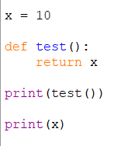
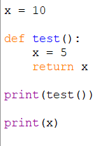
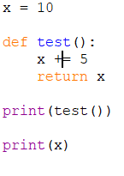
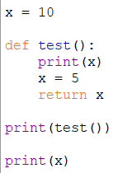
Q2: Scoping Issues
What will be the outputs of the following functions?
10, 10
5, 10
Error!
Error!

Slide 12
Q2: Scoping Issues
Moral: Be extremely careful when reassigning variables from outer scope!
The moment python sees a reassignment (=) operator, the variables becomes local
So how can we get around this?

Slide 13
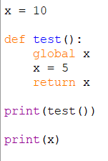
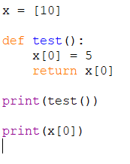
Q2: Scoping Solutions
What will be the outputs of the following functions?
Global is used to bring in a global variable, nonlocal to bring in a variables from outer scope (e.g. function)
5, 5
5, 5

Slide 14
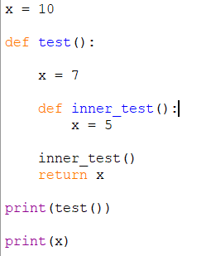
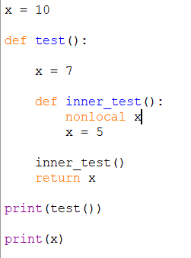
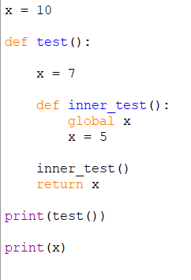
Q2: Scoping Solutions
What will be the outputs of the following functions?
7, 10
5, 10
7, 5

Slide 15
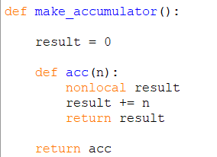
Q2: Solution 1

Slide 16
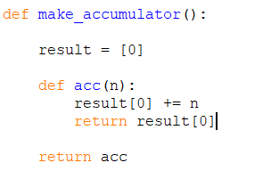
Q2: Solution 2

Slide 17
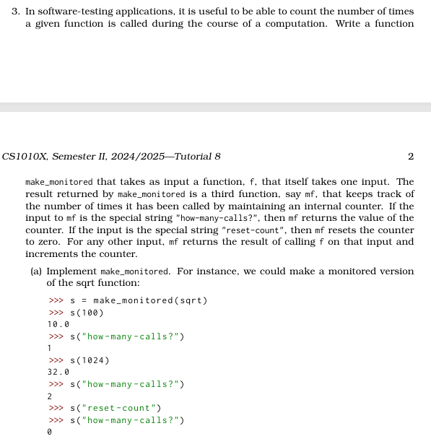
Q3 (a)

Slide 18
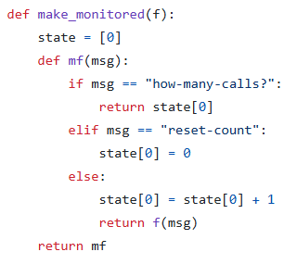
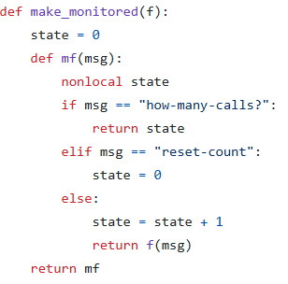
Q3 (a) Solution

Slide 19
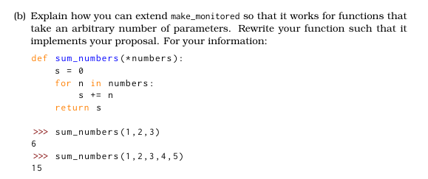
Q3 (b)

Slide 20
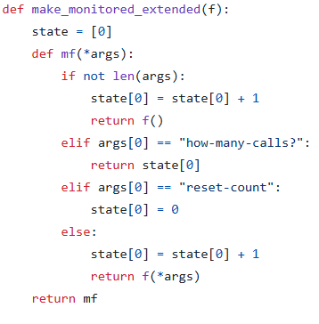
Q3 (b)
What does *args do?
It allows for variable number of parameters! Will be stored as a tuple

Slide 21
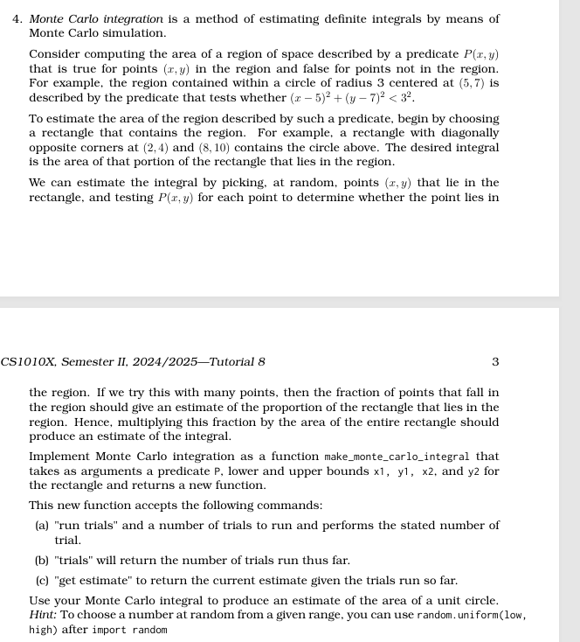
Q4

Slide 22
Q4
What are the variables we need to keep track of?
The number of successes, and total number of trials!

Slide 23
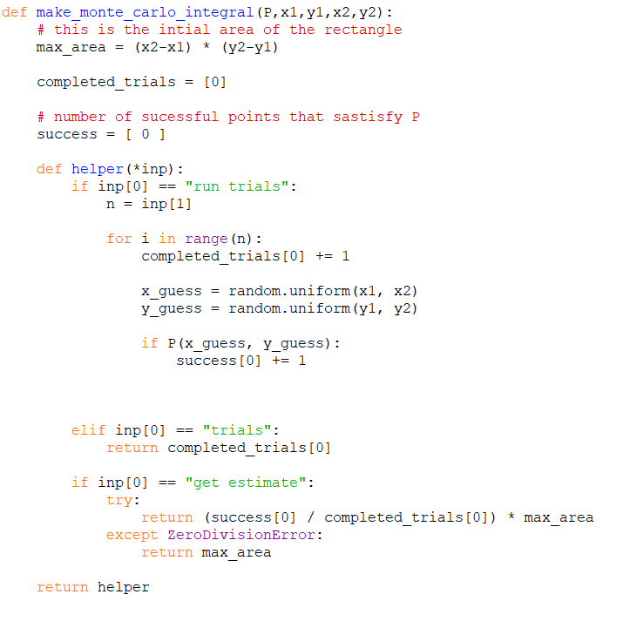
Q4

Slide 24
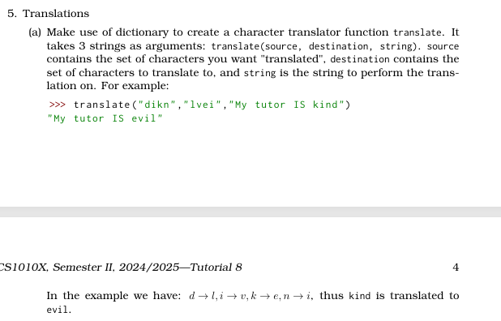
Q5

Slide 25
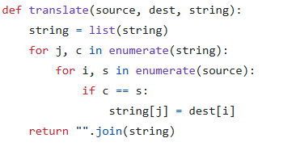
Q5 (a)
Let m be the length of source, n the length of dest and k the length of string
Time Complexity: O(km)

Slide 26
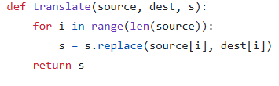
Q5 (a) Does this work?

Slide 27
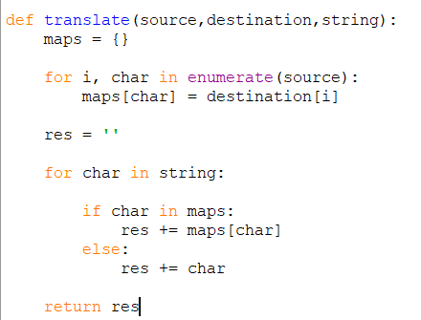
Q5 (a) Alternate Solution
Let m be the length of source, n the length of destination and k the length of string
Time Complexity: O(m + k^2)

Slide 28
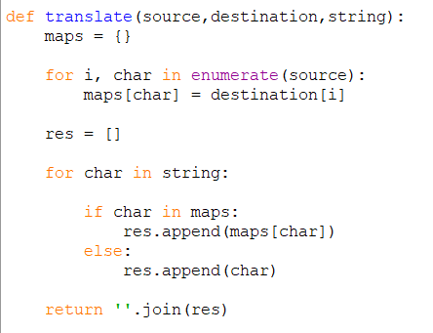
Q5 (a) Alternate Solution
Let m be the length of source, n the length of destination and k the length of string
Time Complexity: O(m + k)

Slide 29
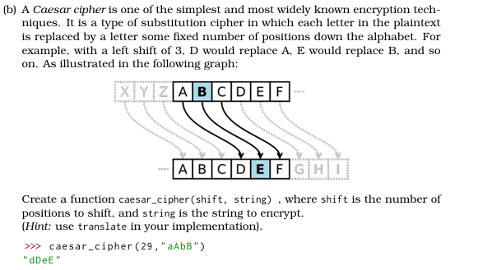
Q5 (b)

Slide 30
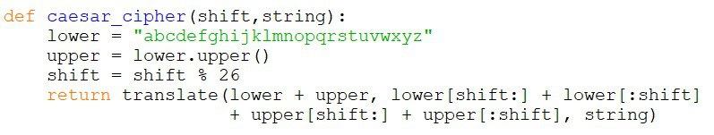
Q5 (b)

Slide 31
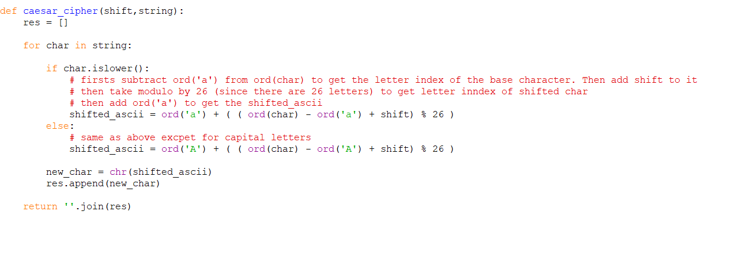
Q5 (b)

Slide 32
The End

Slide 33
Extra Problem No. 1
Finding the kth largest element in a list

Slide 34
Extra Problem No. 1
Trivial Solution: Sort the list, then choose the kth element from the back
Time Complexity: O(nlog n)
Can we do better?

Slide 35
Introducing partition
Suppose we took the first element of the list, and divided the list into elements smaller and larger
Can we use this to create subproblems?

Slide 36
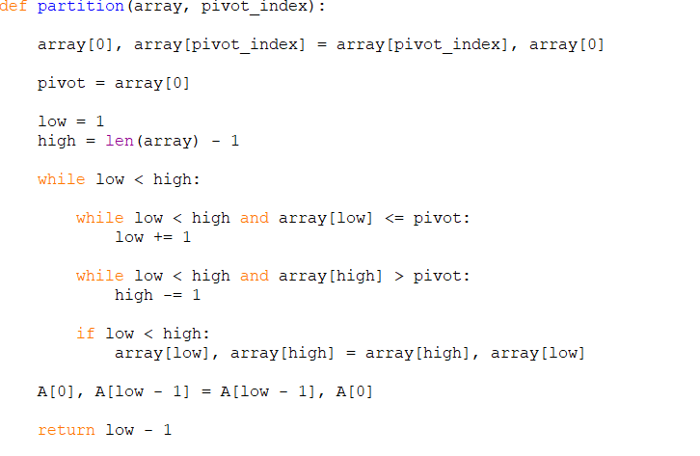
Partition PseudoCode
Time Complexity: O(n)
What do we know about the pivot?
It is in the correct place in the sorted array!

Slide 37
Partition PseudoCode
Time Complexity: O(n)
What do we know about the pivot?
It is in the correct place in the sorted array!
Quick Sort Animation by Y. Daniel Liang

Slide 38
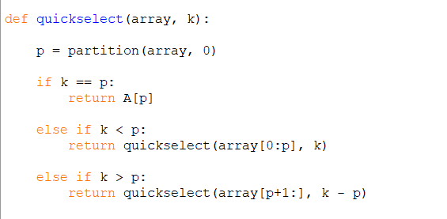
QuickSelect
Pls ignore the slicing.
This can be implemented
Trivially without slicing,
but its easier to visualise with slicing

Slide 39
Find the 4th smallest element of the following array
[ 1, 5, 8, 2, 3, 7, 9, 0, 10, 3 ]

Slide 40
QuickSelect
Covered in CS2030S!
e.g. Find 4th smallest element, take first element as pivot.
2
1
3
5
8
7
9
4

Slide 41
QuickSelect
Covered in CS2030S!
e.g. Find 4th smallest element, take first element as pivot.
Partition the array
2
1
3
5
8
7
9
4

Slide 42
QuickSelect
Covered in CS2030S!
e.g. Find 4th smallest element, take first element as pivot.
Partition the array
1
2
3
5
8
7
9
4
Pivot at 2nd smallest element, recurse to right.

Slide 43
QuickSelect
Covered in CS2030S!
e.g. Find 4th smallest element, take first element as pivot.
Partition the array
1
2
3
5
8
7
9
4
Pivot at 2nd smallest element, recurse to right.

Slide 44
QuickSelect
Covered in CS2030S!
e.g. Find 4th smallest element, take first element as pivot.
Partition the array
1
2
3
5
8
7
9
4
Pivot at 3rd smallest element, recurse to right.

Slide 45
QuickSelect
Covered in CS2030S!
e.g. Find 4th smallest element, take first element as pivot.
Partition the array
1
2
3
5
8
7
9
4
Pivot at 3rd smallest element, recurse to right.

Slide 46
QuickSelect
Covered in CS2030S!
e.g. Find 4th smallest element, take first element as pivot.
Partition the array
1
2
3
4
5
7
9
8
Pivot at 5th smallest element, recurse to left.

Slide 47
QuickSelect
Covered in CS2030S!
e.g. Find 4th smallest element, take first element as pivot.
Partition the array
1
2
3
4
5
7
9
8
Return 4

Slide 48

QuickSelect
What is the worst case time complexity? O(n^2)
But what if we were able to split the list in half every time? Then O(n)!

Slide 49
Randomised QuickSelect
Suppose we did exactly as on the left, but instead of 0, we chose a random pivot
This would give us an
Expected time complexity of O(n)
This is a bit hard to prove, so let us try something simpler

Slide 50
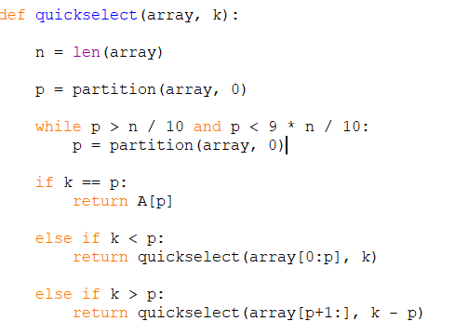
Randomised QuickSelect
What is the expected number of times we run partition?

Slide 51
[ 1, 5, 8, 2, 3, 7, 9, 0, 10, 3 ]
Bad pivot
Good pivot
Bad pivot
Suppose X is the number of times I call partition. What is E(X)?
E(X) = 1(8/10) + (2/10)(1 + E(X))
Solving, E(X) = 1.25.
Thus, we only need to partition an average of twice per call!

Slide 52
Randomised QuickSelect
Time Complexity analysis: T(n) = 2n + T(9/10)
Solving, we will get
T(n) = O(n)
Thus, the EXPECTED time complexity of quick select is O(n), assuming we choose randomised pivots!

Slide 53
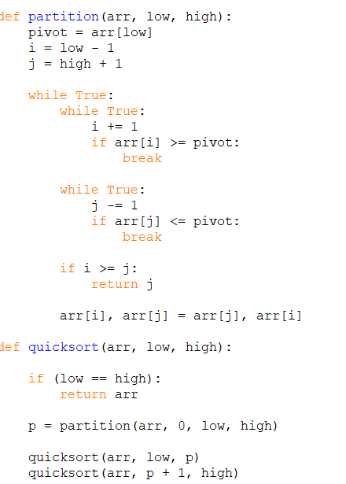
How can we sort the list?
We can use partition to sort the list!
Simply partition the list, and recurse into right and left sides!
Worst case time complexity: O(n^2)

Slide 54
Randomised quicksort
One again, we can do better we a randomised quicksort
Suppose we used a similar method to quickselect in choosing a “good” partition
T(n) = 2n + T(n / 10) + T(9n/10)
T(n) = O(nlogn)

Slide 55
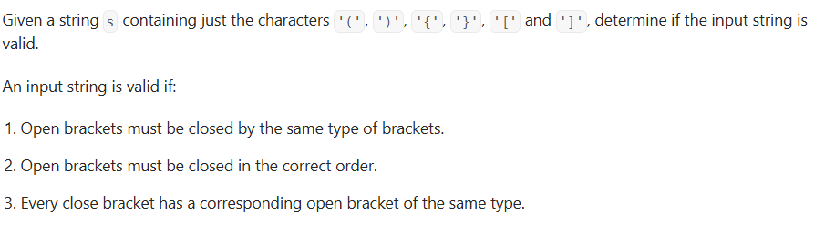
Is Valid Parenthesis?

Slide 56
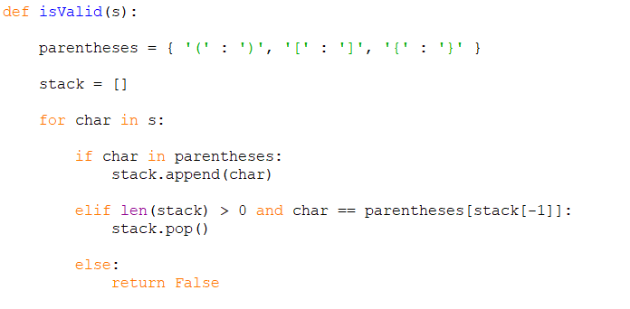
Is Valid Parenthesis?
Time Complexity: O(n)
Space Complexity: O(n)

Slide 57
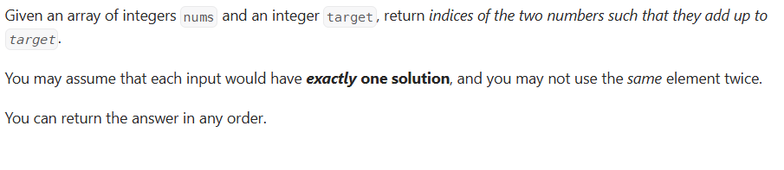
Two Sum

Slide 58
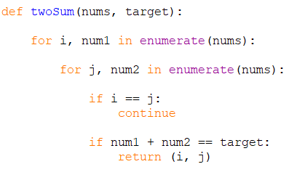
Two Sum
Time Complexity: O(n^2)
Space Complexity: O(1)

Slide 59
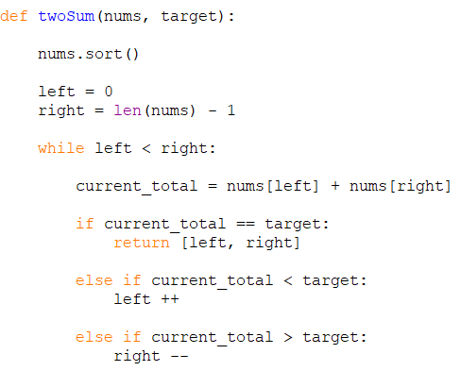
Two Sum
Time Complexity: O(nlogn)
Space Complexity: O(1)

Slide 60
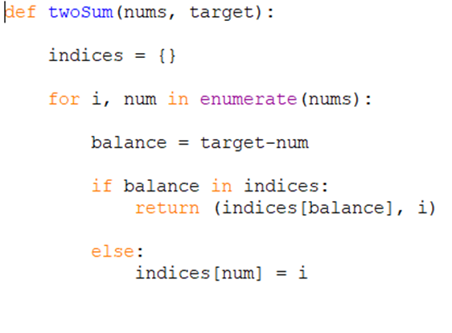
Two Sum
Time Complexity: O(n)
Space Complexity: O(n)

